Slide 1

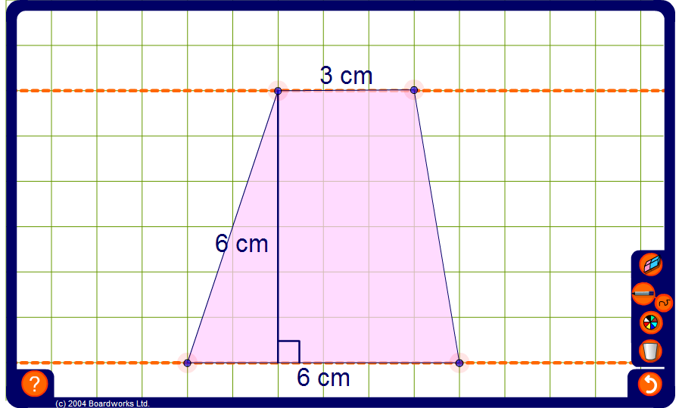


Area of a trapezium
Notes:
Set the pen to draw straight lines and use it to show how to divide the trapezium into triangles and rectangles. Use this to find the areas of different trapezia.
Use the pen tool to show that for any trapezium we can construct an identical trapezium rotated through 180° to make a parallelogram. If we call the lengths of the parallel sides of the trapezium a and b, then the area of the parallelogram is equal to (a + b) times the height. The area of a single trapezium is half the area of the parallelogram and so the area of any trapezium can be found using the formula ½(a + b)h.

